Slide 1
GitHub Copilot
Dev Days
Notes:
Welcome everyone to GitHub Copilot Dev Days. My name is (Insert name), and I’m so excited to be here this is just one of hundreds of global events that GitHub and the development community partnered with to show off the latest and greatest and agentic development with GitHub Copilot.

Slide 2
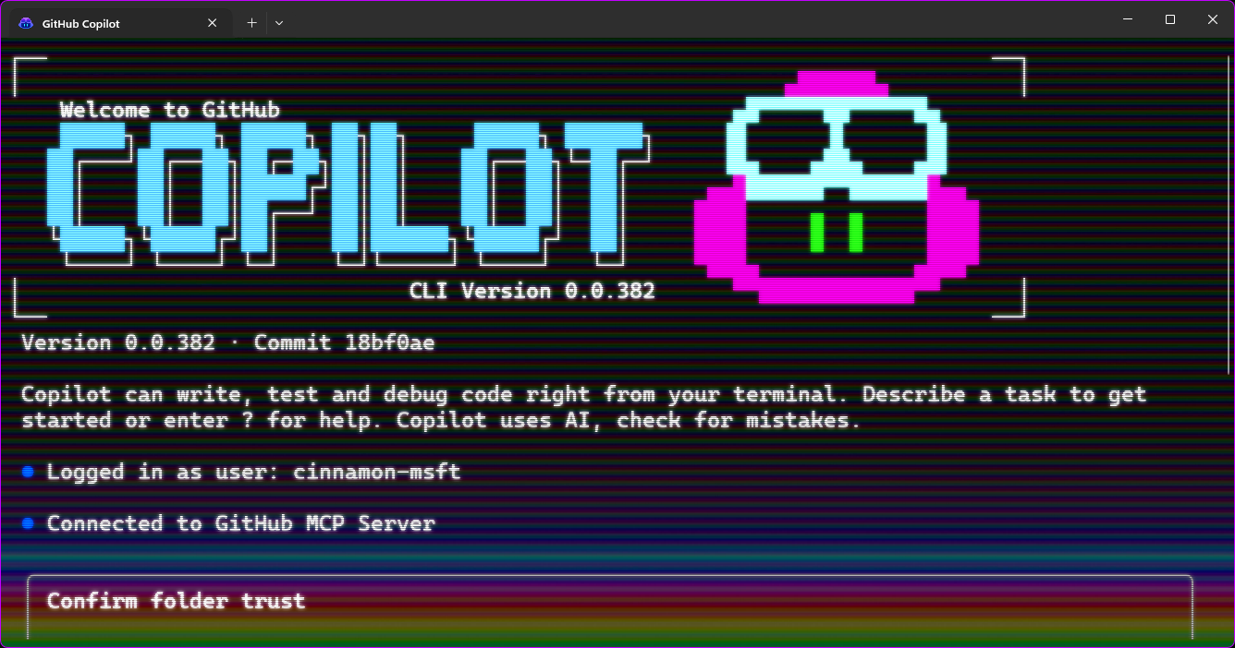
GitHub Copilot CLI – your AI terminal companion
Notes:
OK let's talk about the terminal and GitHub copilot CLI which is your AI terminal companion that gives you all of the powers of GitHub copilot directly in your terminal and so much more

Slide 3
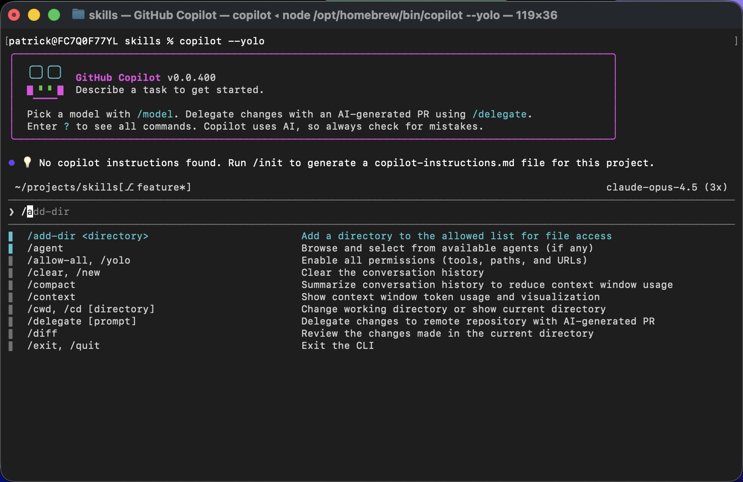
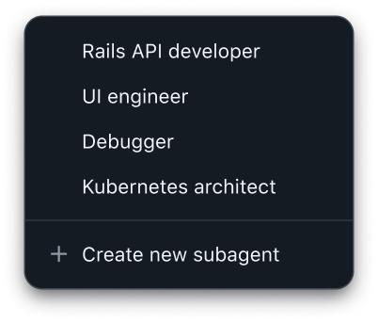
Core Features
What’s in the box
Interactive
Assistance
Headless
Automation
Code Generation
& Modification
Tool Execution
& Shell Commands
Multi-file
context awareness
Lifecycle
event hooks
Modes for
multiple situations
MCP server
integration
Notes:
as you may expect the GitHub copilot CLI is packed full of features obviously including interactive but also headless automation and assistance code generation modification tools execution and script and shell commands it can understand your entire code base and it’s multi file contacts where there’s lifecycle hooks multiple modes for any different situation and of course skill and MCP server integration as well

Slide 4






Many modes. Many use cases.
Interactive
Headless
Server
copilot
copilot –p
copilot --server
User runs CLI locally on their machine with full interactive UI and prompts
Non-interactive execution for automation pipelines and CI/CD workflows
Exposes JSON-RPC port for external clients to drive CLI functionality remotely
Notes:
it can work directly in an interactive mode by just typing in copilot and that's going to allow you to interact with your mouse and keyboard just as you would with any terminal. But you can also run it completely and non interactive mode and that’s really great for automating pipelines or running scripts for example. And then finally there’s a server mode which actually exposes a JSON RPC port and this is actually heavily used with the GitHub copilot SDK which I mentioned a little bit previously in the opening but definitely is worth going deeper into later on

Slide 5
Installation
GitHub Copilot CLI
Windows (WinGet)
macOS / Linux (Homebrew)
Any OS (npm, Node.js ≥ 22)
winget install GitHub.Copilot
brew install copilot-cli
npm install –g @github/copilot
Notes:
the get up copilot CLI is available across windows Mac and Linux you can install it with common tools like winget or homebrew and of course you can install it with NPM as well. Once you have it installed the CLI will automatically update or you can run copilot update and check for updates manually

Slide 6







Powerful
Built-in Agents
Personalized
Custom Agents
The built-in agents are designed to support a wide range of needs with performance and generalization in mind.
Create an .agent.md file in .github/agents/ or ~/.github/agents/ to get started.
---
name: Display Name
description: What the agent does (required)
tools: ["*"] # Optional - defaults to all tools
mcp-servers: # Optional
server-name:
command: npx
args: ["@some/mcp-server"]
---
# Agent Instructions
General | Research | Plan | Autopilot
Full-featured agent using all CLI tools for complex multi-step tasks. | Run deep research investigation using GitHub search and web sources | Create a full implementation plan before coding by specify requirements and answering questions | Works through a task without waiting for your input after each step autonomously until it determines the task is complete.
Frontmatter Fields
Field | Required | Description
name | No | Display name (defaults to filename)
description | Yes | Describes when to invoke the agent
tools | No | Array of allowed tools (default: all)
mcp-servers | No | MCP server configuration
infer | No | Whether agent can be auto-invoked (default: true)
* More details on our Custom Agents docs page.
Notes:
what's really unique about the CLI is that there are powerful agents Built in directly to the CLI the general agent is your coding agent and you give it a prompt and it will go ahead and use the tools and tasks to go off and execute them.
The research agent is set up to do deep research to help you really investigate issues or problems or understand potential features that you might be adding into your code base through GitHub search and also web sources as well and this is really great as it provides full huge documentation on the research topic that you’re giving it
one of the more commonly used is plan agent this will create a full implementation plan it will ask you questions I’ll clarify requirements O once it’s done it’s ready to fully implement exactly to your specification
and something that combines this together is the autopilot mode for these agents which works through all of the tasks without waiting for input every single step and does it all autonomously it’ll automatically figure out the additional steps and tasks that it needs to do to fully complete it
and best of all you can create your own custom agents to specify exactly how you want the specific agent to work what tools are available to it and what MCC servers as well O for example you could create your own code reviewer or your own GitHub expert that you work with directly inside of the CLI

Slide 7
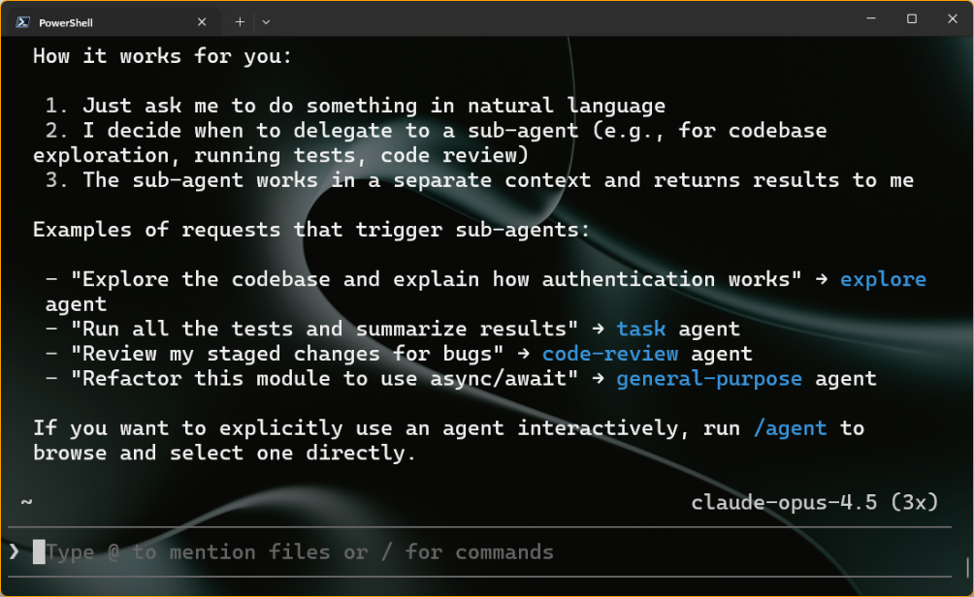
Subagents
Built-in tasks to delegate to specialized AI agents
explore
Fast codebase exploration, finding files, answering code questions
task
Executing commands like tests, builds, lints
general-purpose
Complex multi-step tasks requiring full toolset
code-review
High-signal code review for bugs and security issues
Notes:
There are a bunch of sub agents that are built to directly into the CLI that can run asynchronously and we’ll provide isolated contacts back to the main agent things like exploring the code base executing commands like testing doing builds and linting there’s a general purpose sub agent that will understand complete complex tasks that require the full tool set and there’s even a code review sub agent that’ll identify bugs and security issues as well

Slide 8
Slash commands
/agent
/plan
Switch to a custom agent
Plan out an implementation before writing any code
/model
/cwd or /cd
View all available models and choose which to use
Change working directory mid-session
/mcp
/reset-allowed-tools
Manage your MCP servers
Reset Copilot’s tool permissions
/yolo
/context
Enable all permissions
Info on token usage & context window
/diff
/review
Review changes made in directory
Run a code review to analyze changes
/skills
/plugin
Manage & call skills
Manage and install plugins
Notes:
one thing that you'll use all the time inside of the CLI are slash commands these are things such as switching the agent or model that you want to use going into and out of plan mode or review agent and loading up skills or doing a diff for example. This is just a subset of them there are so many being added all the time to handle different scenarios when working in the CLI

Slide 9
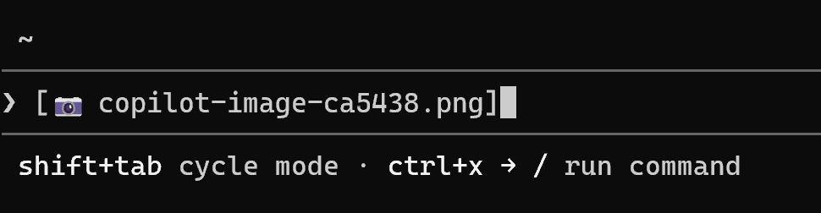
@ to mention files
GitHub Copilot CLI
Provide Copilot context by @-mentioning files directly in your prompt
@-mention multiple files at once, including images
Alternatively drag and drop or paste the file or image to provide context
ALT+V / CMD+V to paste images into CLI
Notes:
another thing that you can do is specifically mention code files that you may want to be working on directly inside of a specific prompt and you can even give it images by dragging and dropping it or pasting it in directly into the CLI and then it can use vision API to understand that image and of course it can read those files directly it’s a nice way to guide the agent into what you need to have done

Slide 10
Built-in tools via MCP servers
GitHub Copilot CLI
github
edit
Provides access to GitHub API operations
Provides file editing capabilities through the filesystem MCP server
bash
web-fetch
Provides shell command execution
Provides HTTP request capabilities for fetching web content

Slide 11
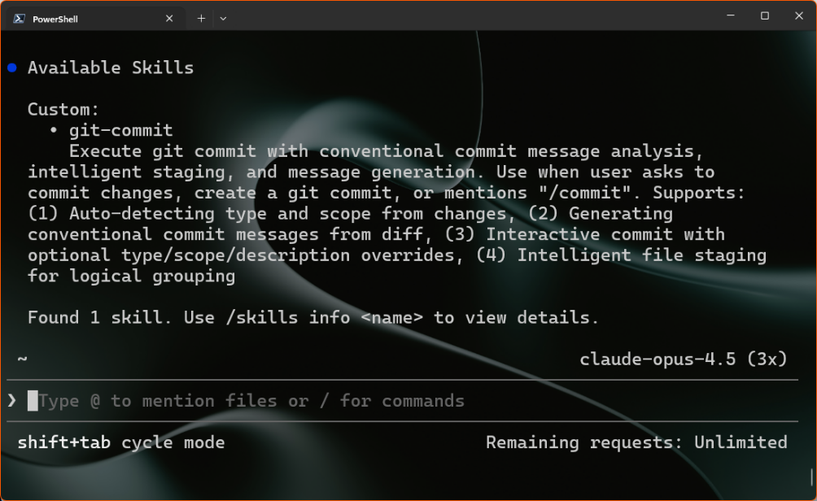
Skills & Plugins
Reusable procedures to extend Copilot’s capabilities for repeatable tasks
Add new skills with /skills add
Can be project-specific or global in your .copilot/skills or .agents/skills folder
Add new plugins with /plugin
Notes:
There are common things available inside the CLI such as custom instructions and prompt files but also skills and plugins give you reusable procedures that extend GitHub copilot's capabilities for these repeatable tasks you can use the add new skills or new plugins directly into your project or in a global setting and what’s great about skills is that they are being able to load on demand so for example you might have one for how to do git commits or how to do image resizing and when you ask it to do a thing it can then load that skill up on demand

Slide 12
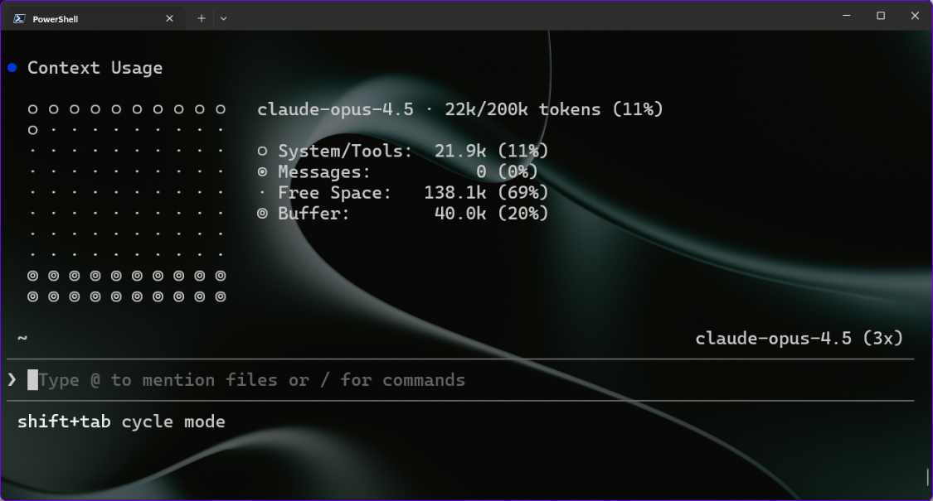
Context
GitHub Copilot CLI
Infinite Sessions (a CLI exclusive) means you likely never have to worry about these, but when you want to manage your context more directly, you can:
/context
/compact
Visualize what is in your context window.
Summarizes current context and compacts to smaller size.
Notes:
the CLI also has powerful context awareness it has this concept of infinite sessions which means you never really have to worry about the context it automatically managed it for you at anytime you can say slash context to visualize the current context and where things are at or do you compact to automatically compact and summarize the current context but because of infinite sessions it does it for you automatically

Slide 13
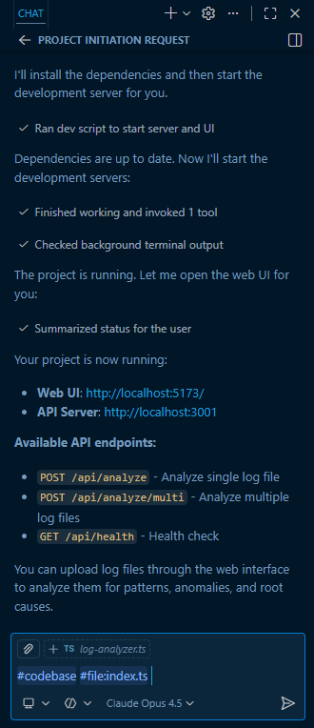
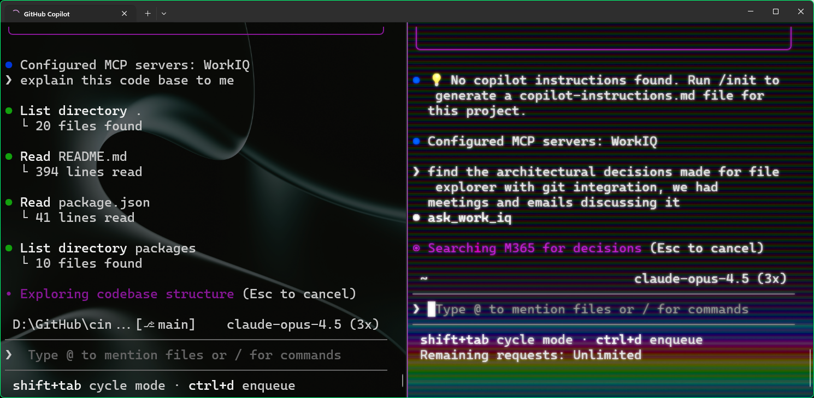
Parallel Copilot
Two projects in terminal split panes
VS Code agent chat
Notes:
the last thing I want to talk about too is that you can be running multiple parallel copilot sessions all at the same time you can have multiple slit tabs for example multiple terminals open you could be running in background task agents inside of VS code either interactively or in the background or in any other IDE as well you can run all of these at the same time across multiple code bases and this is just scratching the surface of the CLI

Slide 14
Demo
GitHub Copilot Dev Days
GitHub Copilot CLI
Notes:
let's go ahead and see it in action

Slide 15


GitHub Copilot Dev Days Sweepstake
All completed surveys are eligible for our sweepstakes to win a GitHub Copilot Pro+ one-year subscription.
https://aka.ms/githubcopilotdevdays/sweepstakes

Slide 16
Thank you
Notes:
alright let's open it up for Q&A

